Slide 1
FoodieFriends
Raymond You | Elizabeth Cho

Slide 2
What is FoodieFriends?
A food/recipe app with social media aspects incorporated
Search for recipes of any category
Join food groups with friends
Send real time messages to other users

Slide 3
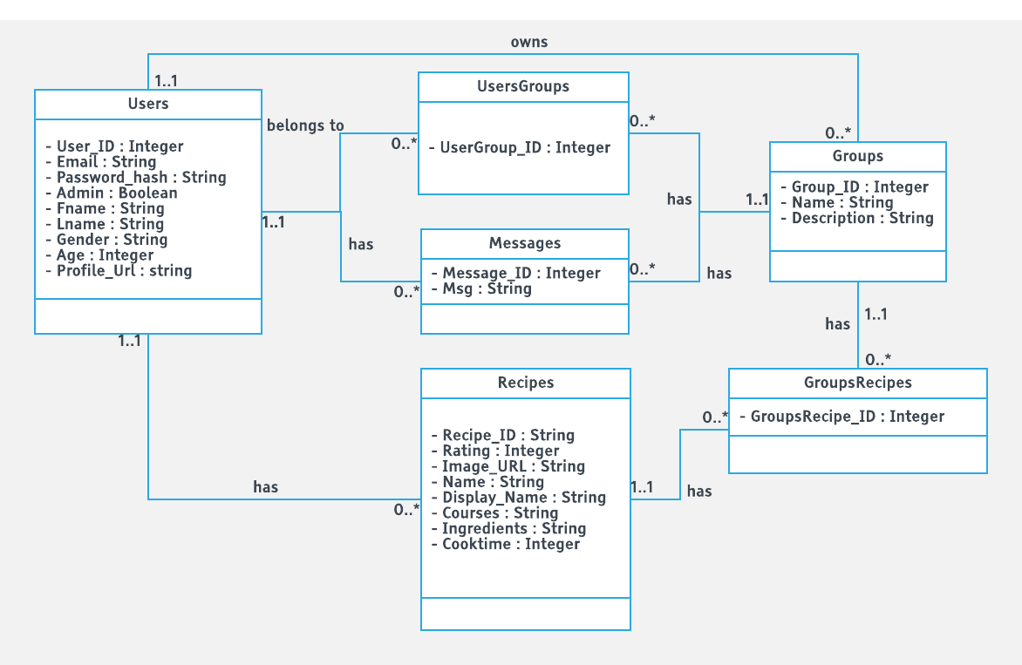
Our Database Schema

Slide 4


Libraries & Tools

Slide 5
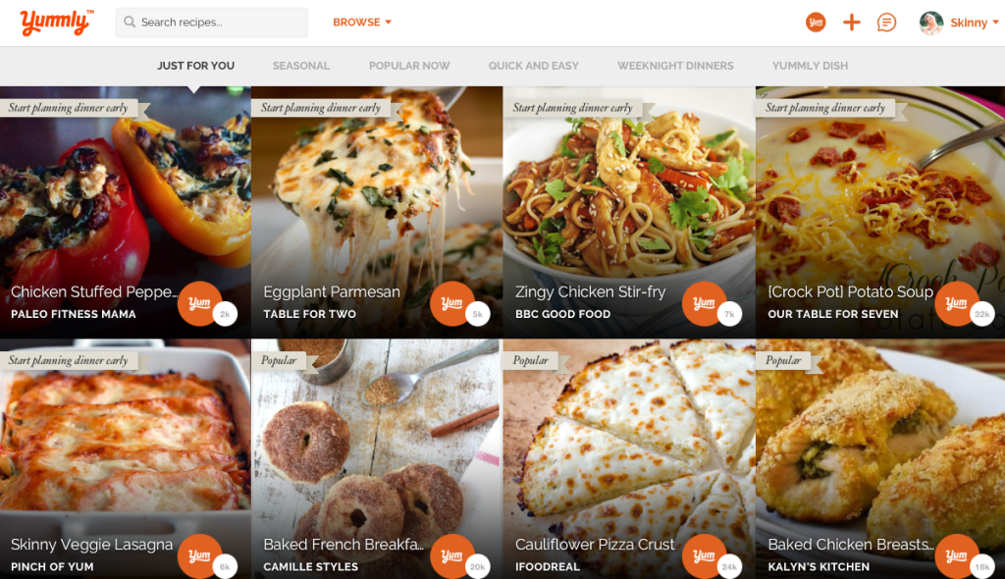
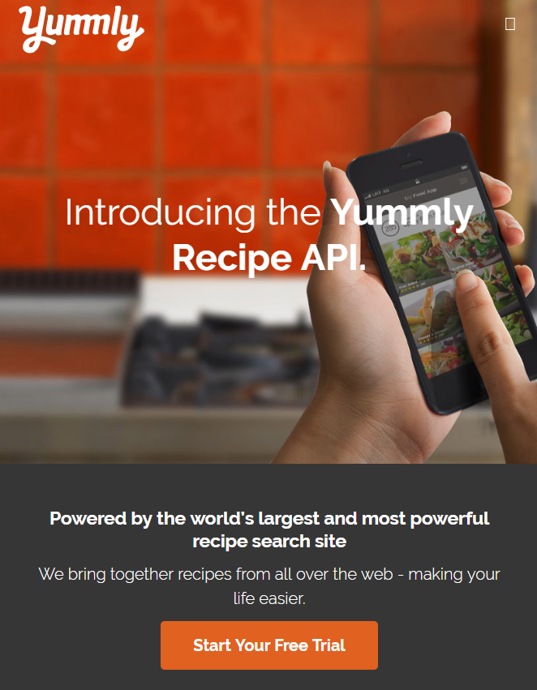
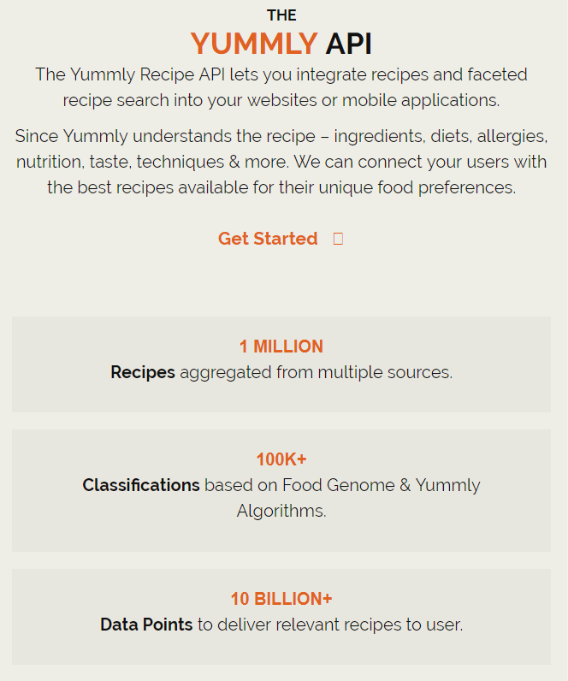
APIs Used (Yummly)

Slide 6


APIs Used (AWS)

Slide 7
Live Demo

Slide 8
Challenges
Passing data around different components
Implementing profile picture upload with S3
Styling the site and making it look passable

Slide 9
Conclusion
Questions?
Comments?

